Slide 1
PROJECT TITLE
TELECOM CUSTOMER CHURN ANALYTICS
Name : Sradhanjali Rana
Industry: Telecom
Function: Operations
Dataset Source: Kaggle – Telecom Churn Case Study Hackathon
Project: Customer Churn Analysis

Slide 2
DATASET SELECTION CRITERIA
Publicly Available Data
Source: Kaggle – Telecom Churn Case Study Hackathon
Multiple Related Files
4 files: train.csv, test.csv, sample.csv, data_dictionary.csv
Sufficient Data Volume
Training dataset: 69,999 records
Training dataset: 172 columns
Test dataset: 30,000 records
Dataset satisfies the requirement of 10,000+ records and 30+ columns
Industry: Telecom
Function: Operations

Slide 3
PROBLEM STATEMENT & BUSINESS OBJECTIVE
Problem Statement
Telecom companies may lose customers when their usage, recharge behavior, revenue contribution or service engagement changes over time. The business needs to understand customer behavior and identify patterns associated with churn.
Business Objectives
Identify factors associated with customer churn
Understand customer usage and recharge behavior
Identify high-risk customer segments
Support customer retention strategies
Reduce customer attrition
Improve customer lifetime value

Slide 4
DATA DESCRIPTION
File Description
File | Description
train.csv | Customer-level telecom data containing usage, recharge, service and churn information
test.csv | Customer-level telecom data used for churn prediction without the target variable
sample.csv | Sample submission format for the prediction task
data_dictionary.csv | Definitions of telecom acronyms and variables
Dataset Overview
Train: 69,999 records × 172 columns
Test: 30,000 records × 171 columns
Data Dictionary: 36 variables/acronyms

Slide 5
DATA DICTIONARY – KEY VARIABLES
Variable | Meaning | Business Relevance
id | Unique customer identifier | Customer identification
circle_id | Telecom circle/area | Geographic analysis
ARPU | Average Revenue Per User | Customer revenue
MOU | Minutes of Usage | Voice usage
AON | Age on Network | Customer tenure
ONNET | Calls within same operator network | Network usage
OFFNET | Calls outside operator network | External calling behavior
RECH | Recharge | Recharge behavior
AMT | Amount in local currency | Monetary value
DATA | Mobile internet | Data service usage
VOL | Mobile internet usage volume in MB | Data consumption
2G / 3G | Mobile network technology | Data usage type
FB_USER | Facebook service usage | Service engagement
VBC | Volume Based Cost | Usage-based cost
*.6 / *.7 / *.8 | June / July / August KPI | Monthly behavior
churn_probability | Churn target (0/1) | Churn outcome
Source: Kaggle – Telecom Churn Case Study Hackathon Data Dictionary

Slide 6
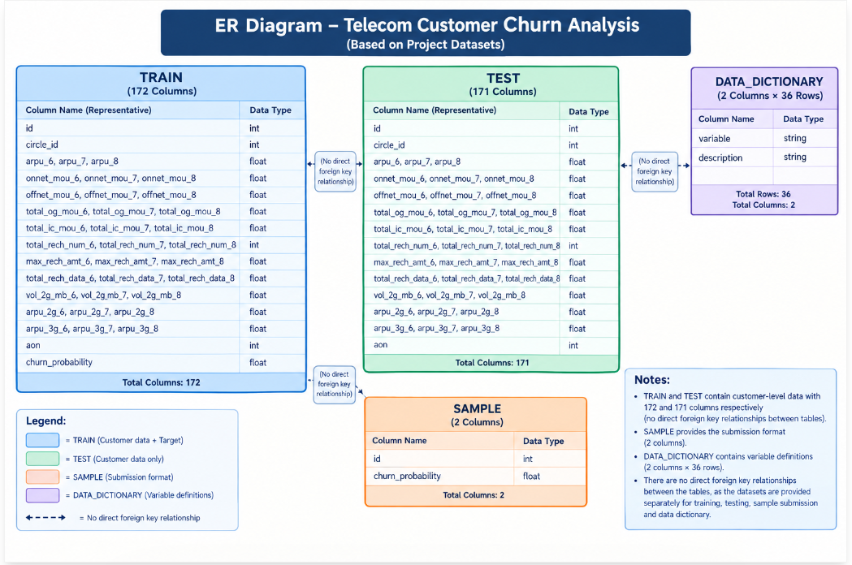
ER DIAGRAM
Dataset Structure: The project uses separate training, testing, submission and data-dictionary files.
Note: The datasets do not contain direct foreign-key relationships; they are used for different stages of the churn analysis workflow.

Slide 7
TECHNOLOGY STACK
Technology | Purpose
Excel | Initial data review and documentation
SQL – Snowflake | Data querying, filtering and joining
Python – Jupyter Notebook / DataBricks | Data cleaning, analysis and predictive modeling
GitHub | Code management and version control
Streamlit | Interactive data application
Power BI | Dashboard, KPIs and data visualization

Slide 8
DATA ANALYSIS PERFORMED
1. Data Quality Analysis
Missing value analysis
Null value checks
Duplicate customer ID check
Unique customer validation
2. Customer Behavior Analysis
Churn distribution
ARPU analysis
Customer tenure analysis
Recharge behavior analysis
Voice usage analysis
Data usage analysis
3. Trend & Diagnostic Analysis
Monthly ARPU trend
Churn vs ARPU
Churn vs tenure
Churn vs recharge
Churn vs voice usage
Churn vs data usage
Descriptive Analysis → Diagnostic Analysis → Predictive Analysis

Slide 9
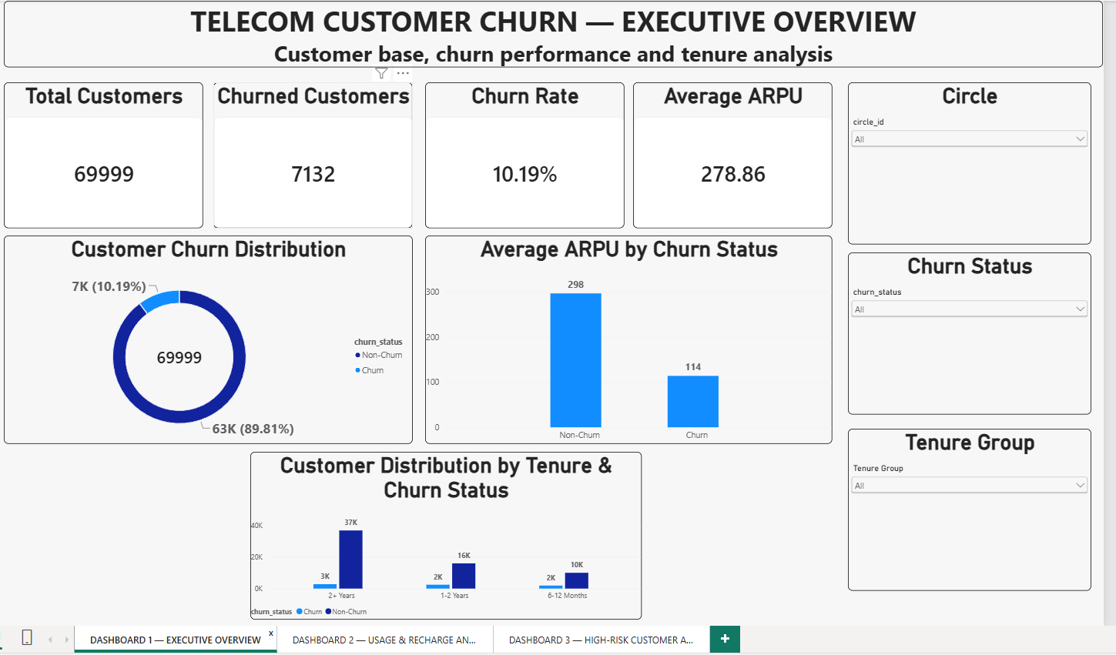
POWER BI DASHBOARD 1 — EXECUTIVE CHURN OVERVIEW
Purpose: Provides an executive-level view of the customer base, churn rate, ARPU and tenure distribution.
Business Use: Helps stakeholders monitor overall churn performance and identify customer segments for further analysis.

Slide 10
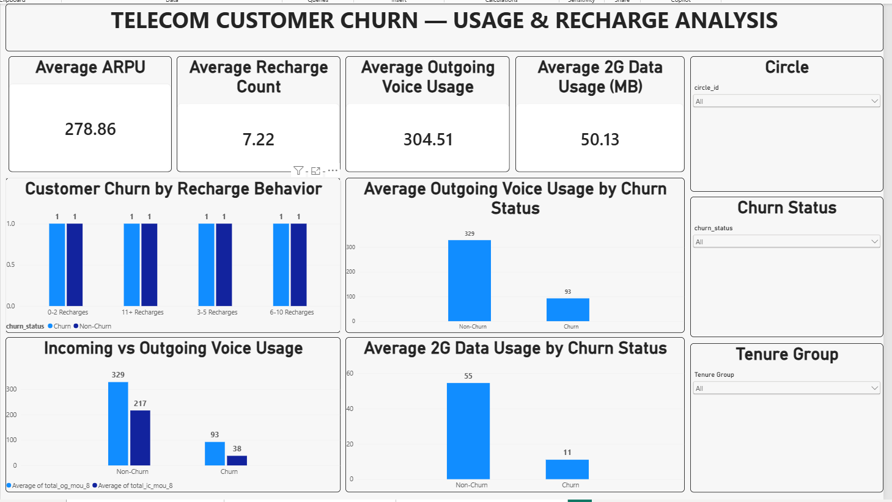
POWER BI DASHBOARD 2 — CUSTOMER USAGE & RECHARGE ANALYSIS
Purpose:Analyzes customer recharge, voice usage and data usage patterns across churn status.
Business Use:Helps identify usage and recharge patterns associated with customer churn.

Slide 11
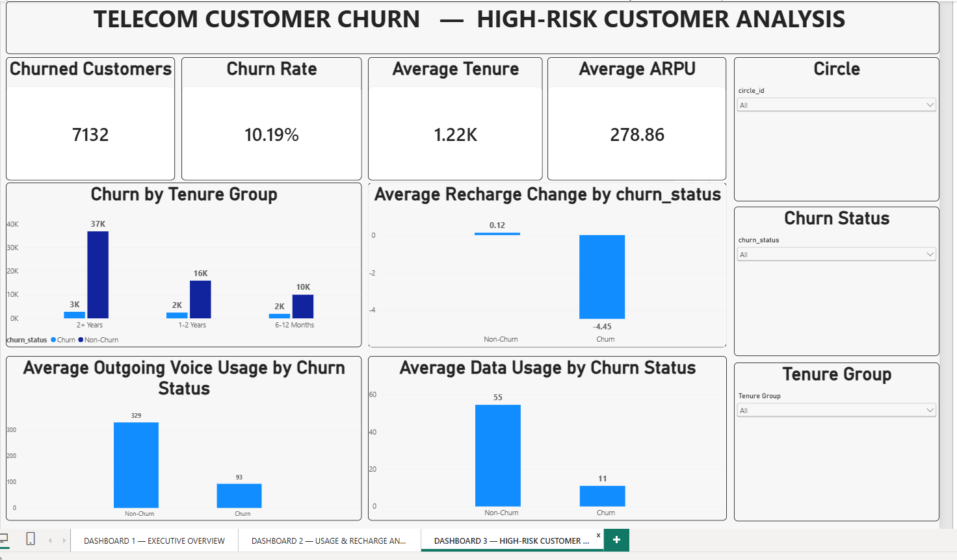
POWER BI DASHBOARD 3 — HIGH-RISK CUSTOMER ANALYSIS
Purpose:Analyzes churn across tenure, recharge, voice usage, data usage and ARPU.
Business Use:Helps identify customer segments that require further retention analysis.

Slide 12
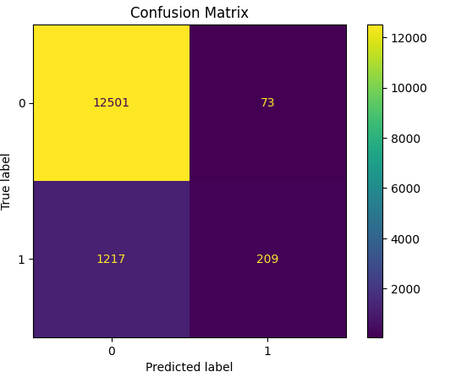
PREDICTIVE MODELING — LOGISTIC REGRESSION
Model: Logistic Regression
Objective: Predict customer churn probability
Target Variable: churn_probability
Target Classes: 0 = Non-Churn, 1 = Churn
Input Features: ARPU, tenure, recharge, voice usage and data usage
Purpose: Estimate the probability of customer churn
Business Use: The model provides a baseline churn prediction that can support customer retention analysis.

Slide 13
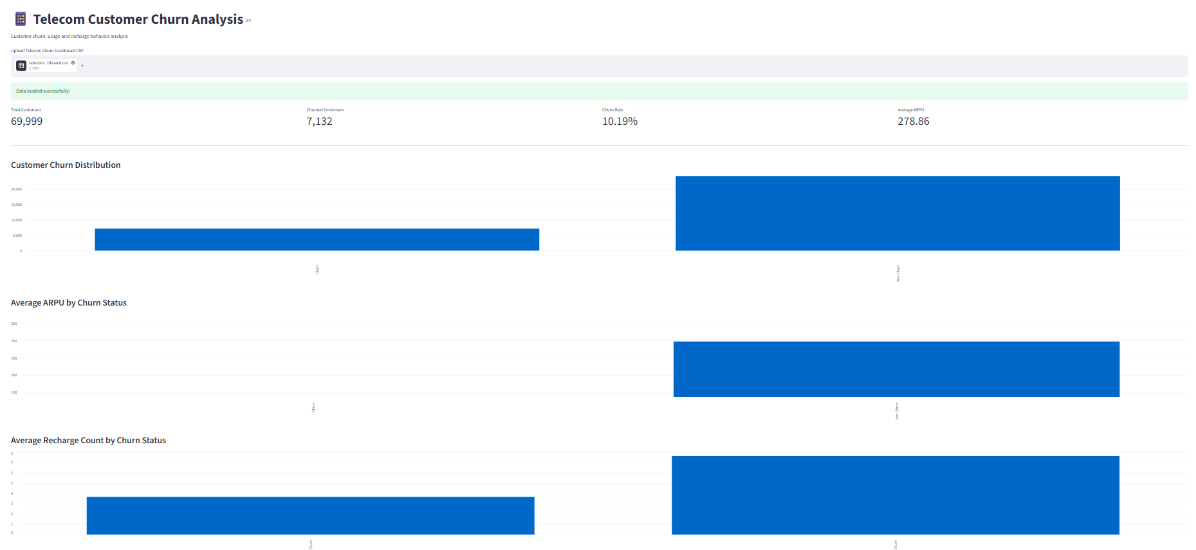
STREAMLIT APPLICATION — TELECOM CUSTOMER CHURN
Purpose: Provides an interactive web-based interface for exploring telecom customer churn.
Technology: Python + Streamlit

Slide 14
END-TO-END PROJECT WORKFLOW
Dataset
↓
Excel — Initial Data Review
↓
Snowflake — SQL Analysis
↓
Databricks — Data Cleaning & Python Analysis
↓
Logistic Regression — Churn Prediction
↓
Power BI — Interactive Dashboards
↓
Streamlit — Web Application
↓
GitHub — Project Documentation
End-to-end workflow for telecom customer churn analysis, from data preparation to business visualization and predictive modeling.

Slide 15
KEY FINDINGS
Overall churn rate is 10.19% across 69,999 customers.
7,132 customers are classified as churned.
Customer ARPU, recharge behavior and usage patterns differ across churn status.
Tenure-based analysis helps identify customer groups with different churn patterns.
Logistic Regression provides a baseline approach for estimating churn probability.
These findings can support further customer retention and churn-reduction analysis.

Slide 16
CONCLUSION
The project analyzed customer churn using telecom usage, recharge, revenue and tenure data.
Snowflake SQL was used for data verification and analysis.
Databricks Python was used for data cleaning, analysis and Logistic Regression.
Power BI dashboards provided interactive churn and customer behavior analysis.
Streamlit provided a simple web-based interface for exploring the analysis.
The project provides a foundation for customer retention and churn analysis.
Overall, the project demonstrates an end-to-end approach to telecom customer churn analytics.

Slide 17
THANKS

